Slide 1
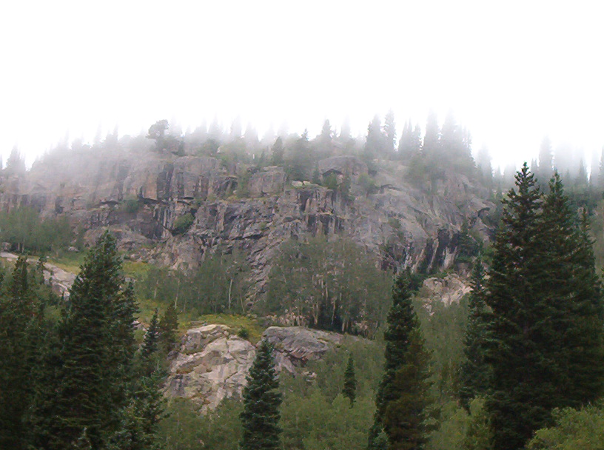
HATCHET
BY
GARY PAULSEN
Imagine being stranded. You are completely alone, in the wilderness. The sights, sounds, smells—everything—is new and unfamiliar. You have no food. You have no water. You have no way to contact the outside world. You are alone, with just your courage. You’re not even sure you have courage! What will you do? Will you make it?
Do YOU have what it takes to survive?

Slide 2
Lets check out some airplane info. Go to http://www.allstar.fiu.edu/aero/princ1.htm . Use the diagram on your worksheet, and label the following; propeller, fuselage, right & left aileron, right & left flap, horizontal stabilizer, vertical stabilizer, rudder, and landing gear.
Now that you know the basic parts of a plane, tell how it flies, be sure to mention the 4 forces of flight.

Slide 3
Ok, we know that Brian is alone in the wilderness. Lets find some ideas to help him survive. Go tohttp://www.equipped.com/kidprimr.htm .
1. What does S.T.O.P. mean? 2. Give two examples of a shelter you could make. 3. How can you attract attention? 4. What about water? 5. List three tips given about water. 6. What are the five rules of improvisation?

Slide 4
4. What kind of animals are out there? Go to http://www.animals.nationalgeographic.com . Look up and describe the following animals moose, porcupine, wolf. Write 3 interesting facts per animal.

Slide 5
5. What if Brian gets hurt? What should he do? Go tohttp://www.mayoclinic.com/health/FirstAidIndex/FirstAidIndex . Give the first aid procedure for each of the following. Blisters, bruise, cuts & scrapes, fever, frostbite, sprain, sunburn.

Slide 6
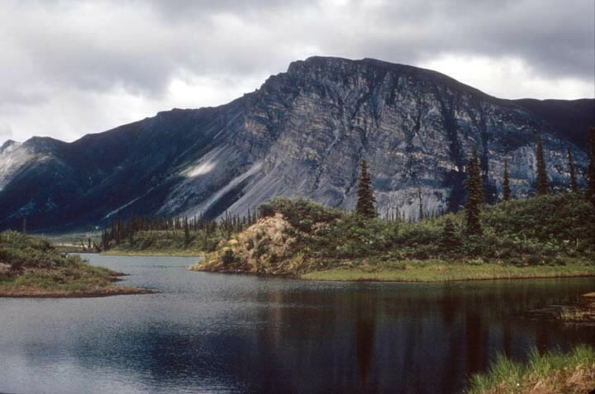
Just How Tough Are You?
Before Reading Activity #2
In the novel Hatchet, Brian must learn to survive without any plan or formal training. Would you be able to do this? To learn if you have what it takes to be a survivor, take the Survival Quiz by clicking here: http://www.wilderness-survival.net/
On your paper, record your results. (How did you do? Could you lead us all on a camping trip through the wilderness?) Write a paragraph in which you record the area(s) you had the most trouble with. Were you surprised by the results? Explain.

Slide 7
CHALLENGE A. Brian's plane is losing altitude (height). How can he correct it , and return the plane to level flight? B. He needs to find an airport to make an emergency landing. What Canadian city might have one? C. Brian crash lands the plan in a clearing. What should he do to improve his chances of survival? D. While getting firewood, Brian sprains his wrist. What should he do? E. Brian notices moose in the area. Need he be concerned for his safety ? F. Brian finds some fishing line and hooks in the plane. While fishing in the nearby pond he cuts himself. What should he do?

